Slide 1
QuestionPeach A New World of Surveys
Class Project
CSCI 6442
George Washington University
Spring 2014

Slide 2
Agenda
Introduction to the Project—DCR
Data Model – Builder Team
Star Schema Model – Analyzer Team
Project Organization—System Engineering Team
Builder Team
Analyzer Team

Slide 3
Project Introduction
Goals
Use lessons of the course
Transaction Processing
Data Warehouse
Provide a work-like experience
20 people on one project, not just 3 or 4
Evolving requirements
A demanding customer
High quality UI requirements
Continual testing and evolution

Slide 4
Classroom Software Engineering
High level of communication to all participants
Class email list goes to all project participants
Used for project communications
Activities that are normally serialized can be done in parallel
Data modelling
Use case development
No time to build infrastructure
WordPress provides userids, Web infrastructure
Lots of public documentation, plugins help WordPress development

Slide 5
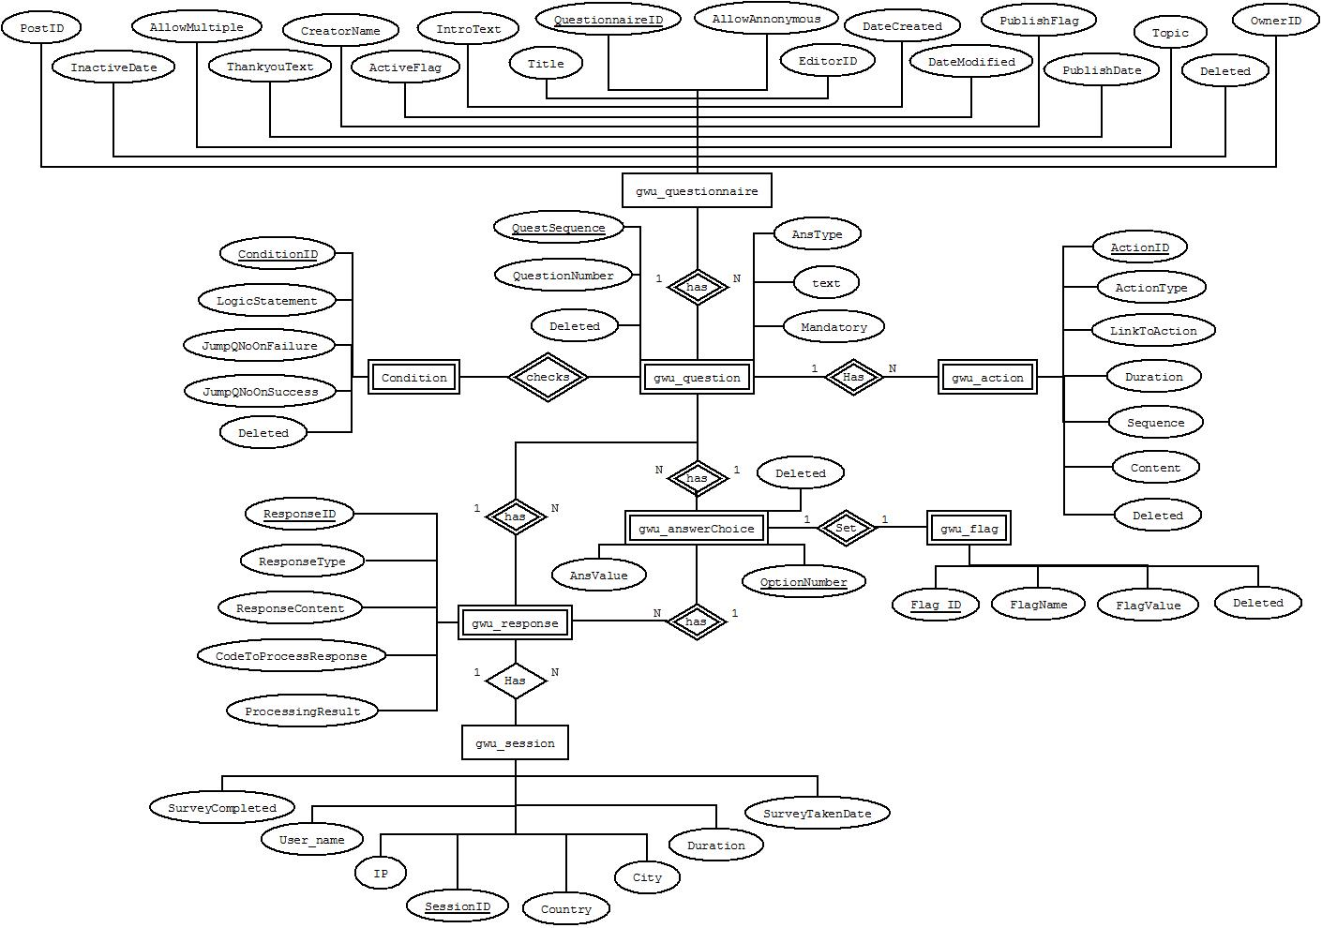
Data Model – Chen’s Model

Slide 6
Normalization and Roberts’s Rules
Normalization:
1NF is followed – All attributes of the entity are atomic
2NF is followed – All the attributes are about the entity
3NF is followed – There are no transitive dependencies
4NF is followed – There are no multi-valued dependency
BCNF is followed – There are no overlapping candidate keys
Roberts’s Rules:
RR1 is followed – All attributes are about the entity
RR2 is followed – No repeated facts
RR3 is followed – Each tuple is present only once
RR4 is followed – No attributes have cardinality greater than 1

Slide 7
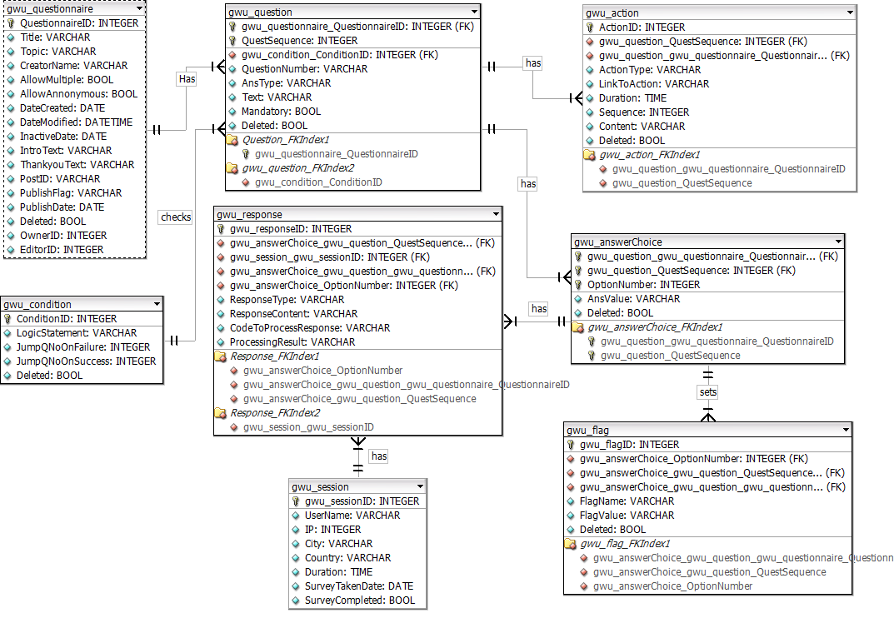
Data Model – Crow’s Foot

Slide 8
Project Organization
Three teams and roles of each
System Engineering Team: Direct the project technical efforts
Test and Confirm the designed project to meet customer requirements
Builder Team: A plugin for users to create, publish and distribute online surveys
Analyzer Team: A plugin for users to analyze the results of each survey
Independent testers and roles of each
Monisha&Iswarya
Testing of builder and analyzer plugin development
Unit testing
Integration testing

Slide 9
Builder Team
Responsibilities
Team Organization
Software organization

Slide 10
Responsibilities
March 19 – March 25
Form teams
Choose team leader
March 26 – April 1
Improvised Data Model
Use cases.
April 2 – April 8
Questionnaire creation
Work on the data model.
Develop a plugin that:
Creates tables on installation.
Display tables on page.
April 9 – April 15
Lock the data model.
April 16 – April 29
Update data model to reflect roles.
Condition Creation
May
Testing and recovery.
Deletes tables on uninstallation.
Question creation
ORM
Response Page
Publishing the questionnaire
Flags Creation
Action display
Updated the plugin
Action Creation
Condition Evaluation
Multiple action support
Edit and delete functionality
Questionnaire duplication
Created new theme
Action upload feature

Slide 11
Tasks Organization
Survey Creation
Question Creation
Condition Creation
ORM
Model Creation
Wrapper function Creation
Taking Survey
Response recording
Condition Evaluation
Action Creation
Action Display
Use Case
Data Model
Initial Design

Slide 12
Software Organization
Survey Creation
Survey Taking
Display questionnaire
Record response
Evaluate condition
Action display
Question and question choice creation
Action creation
Flag creation
Logic and branching creation
ORM
Database

Slide 13
Builder Team
Individuals and Responsibilities

Slide 14
Builder Team – Mustafa Dasorwala
Responsibilities:
Dividing the tasks among team members
Discussing and resolving issues faced by team
Finalizing implementation logic
Worked on Data Model
Created the ORM
Implemented Action creation functionality
Created Questionnaire Duplication functionality
Implemented Condition Parser
Performed White Box Testing

Slide 15
One Chart Per Person—Accomplishments

Slide 16
Builder Team – Sachin Telalwar
Responsibilities:
Started with studying project and understanding already implemented application such as survey monkey etc
- Data Model :
Worked on Data Model
- Use case design :
Part of use case designing team
We came up with 9 test cases initially and I wrote 3 use cases and presented it.
- ORM :
I was part of ORM designing team.
Studied ORM like Doctrine, Yii and Wp-ORM. We used Wp-ORM and modified it accordingly our need
We created Wrapper class so that every developer can use ORM functionalities.
- Displaying questionnaire from URL :
Given a URL display all question according to their type.
- Saving responses :
Developed a logic to save all the responses given by user.
- Branching :
Get the flag values based on user responses.
Compare the flags with logic statement stored in database
Decide whether they match or not and depending on that display next question
- Unit testing

Slide 17
Builder Team - Monisha
Responsibilities:
Make changes and maintain the data model
Manually populate data in the tables
Change the corresponding plug-in depending on the changes in the data model
Testing of builder team development
Unit testing
Integration testing

Slide 18
Analyzer Team
Responsibilities
Team Organization
Software organization

Slide 19
Responsibilities
Feb 19 – Mar 25
Form the team
March 26 – April 12
Divide the responsibility
Ashley-Builder
March 26 – April 12
Weekly Meeting with professor to report the progress of the plugin development
Do the research for the WordPress and Plugin
April 12 – April 19
Create the role and capability of the plugin
April 19– April 29
Improve the role and capability
Create OwnerId and EditorId and save their relations to support the role filter implementation
May
Integrate Two plugins
Introduce WP
Chandan-Analyzer
Guide Team members to develop plugin and to use databases
Create the UI for owner to view editors
Give suggestions to both teams

Slide 20
Team Organization
1st Phase
Team as a whole worked on data model.
2nd Phase
Use Cases.
3rd Phase
Database programmers.
Star Schema Data Model.
Plugin Development.
Plugin programmers.
Testers.
GUI designers.

Slide 21
Software Organization
Analyzer
GUI
View graphical results
Behind The Scene
Create tables
Data migration
Create filters
Cron job
Drop tables
Export reports as PDFs
Generate analytical reports based on filters

Slide 22
Analyzer Team
Individuals and Responsibilities

Slide 23
Individuals and Responsibilities
Iswarya Parupudi
Use cases
GUI Design
Harsh Shah
GUI design
Yash Shah
Hrishikesh Sadar
Use cases
Cron job back up plan
Data model
Testing
Testing

Slide 24
Individuals and Responsibilities
Sonal Sonavane
Export to PDF
Ibou Diallo
Plugin creation
Kholood Alnowaiser
Team leader
Data model
Alemberhan Getahun
Plugin creation
Filters Implementation
Data migration
Filters Implementation
Cron job
GUI implementation
Filters Implementation

Slide 25
One Chart Per Person—Accomplishments

Slide 26
Introductory Demonstration
Quick View of Builder and Analyzer Capabilities—System Engineering Team

Slide 27
Builder Team Demonstration
Detailed demonstration of builder capabilities

Slide 28
Analyzer Team Demonstration
Detailed Demonstration of Analyzer Capabilities

Slide 29
QuestionPeach V 2.0

Slide 30
Thanks!

